Slide 1


Team 30: ECEN 215 Lab Kit
Bi-Weekly Update 5 Members: Luis Diaz-Santini, Yusuf Hossain,
Ryan Freed, and Peter Zhang Sponsor: Dr. Lusher
TA: Garret Brown
Notes:
Intro should take 30 seconds

Slide 2
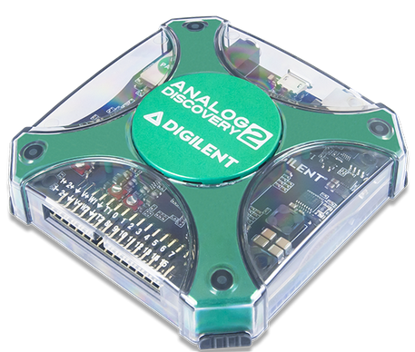
Project Summary
Problem Statement:
Principles of Electrical Engineering (ECEN 215) teaches the basics of electric circuit analysis and electronics to non-ECEN majors.
The transition of ECEN 215 to an online format poses a challenge due to its lab component relying on the Analog Discovery 2 (AD2), which is expensive.
Solution Proposal:
The ECEN 215 Lab Kit offers a solution to the cost, convenience, and over complication issues that are abundant with the AD2. Aiming for a $50 price point, the lab kit offers a more catered simpler approach to each lab while also making it possible to complete at home.
Will operate as the power supply, signal generator, multimeter, and Oscilloscope.

Slide 3
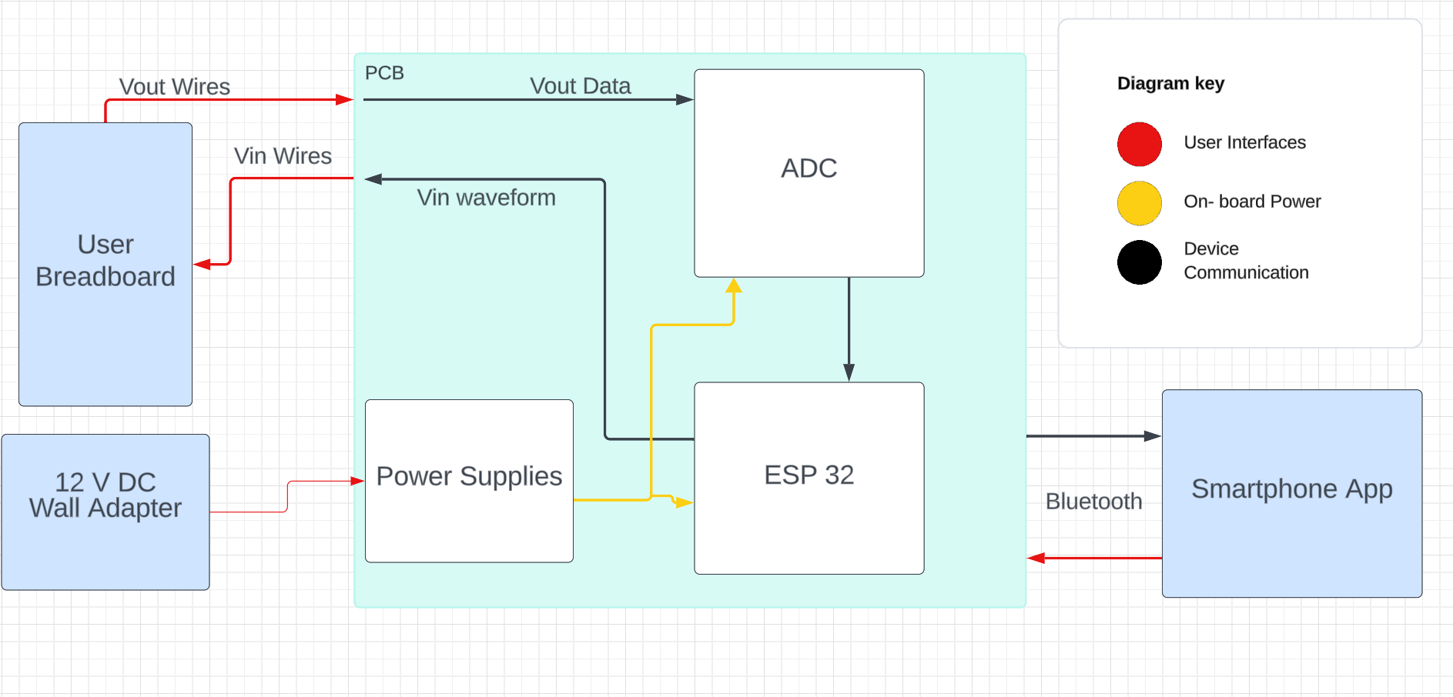
Subsystems Overview
Peter: Multimeter and Oscilloscope
Yusuf: Waveforms and communicating to the microcontroller.
Luis: Mobile application to interface with device
Ryan: PCB design and power.

Slide 4
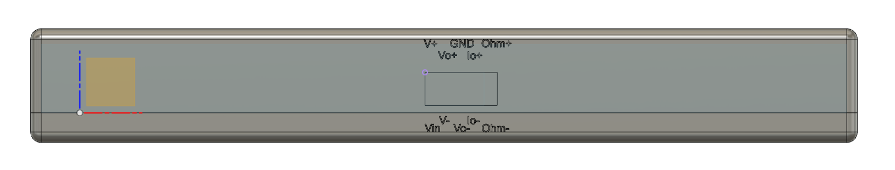
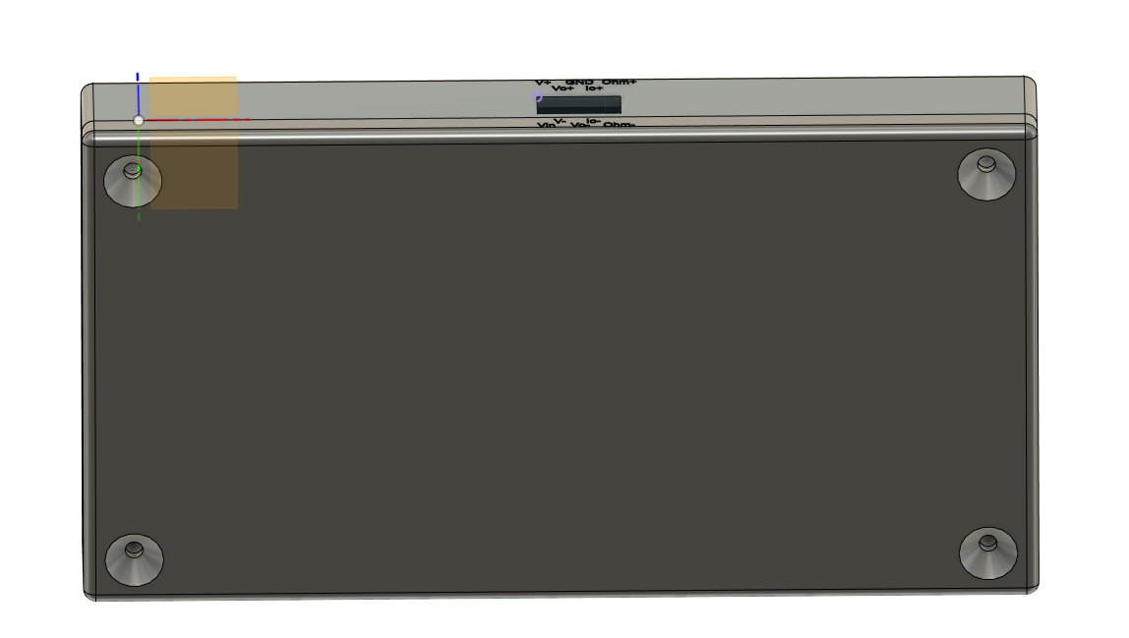
System Enclosure CAD

Slide 5
Demo Deliverables
Show BLE connection
App connects to device
Show multimeter functionality
Measure voltage, resistors, and current within the constructed circuit
Use lab’s multimeter to compare results
Show wave generator functionality
Following the lab manual do: sine wave, square wave, triangle wave
Use lab’s oscilloscope to confirm accurate wave generator output
Show Oscilloscope functionality
Measure Vin and Vout using oscilloscope
Obtain amplitude and phase shift
Use lab’s oscilloscope to confirm results
Showcase power supply functionality
Just measure power output from lab kit with normal multimeter

Slide 6
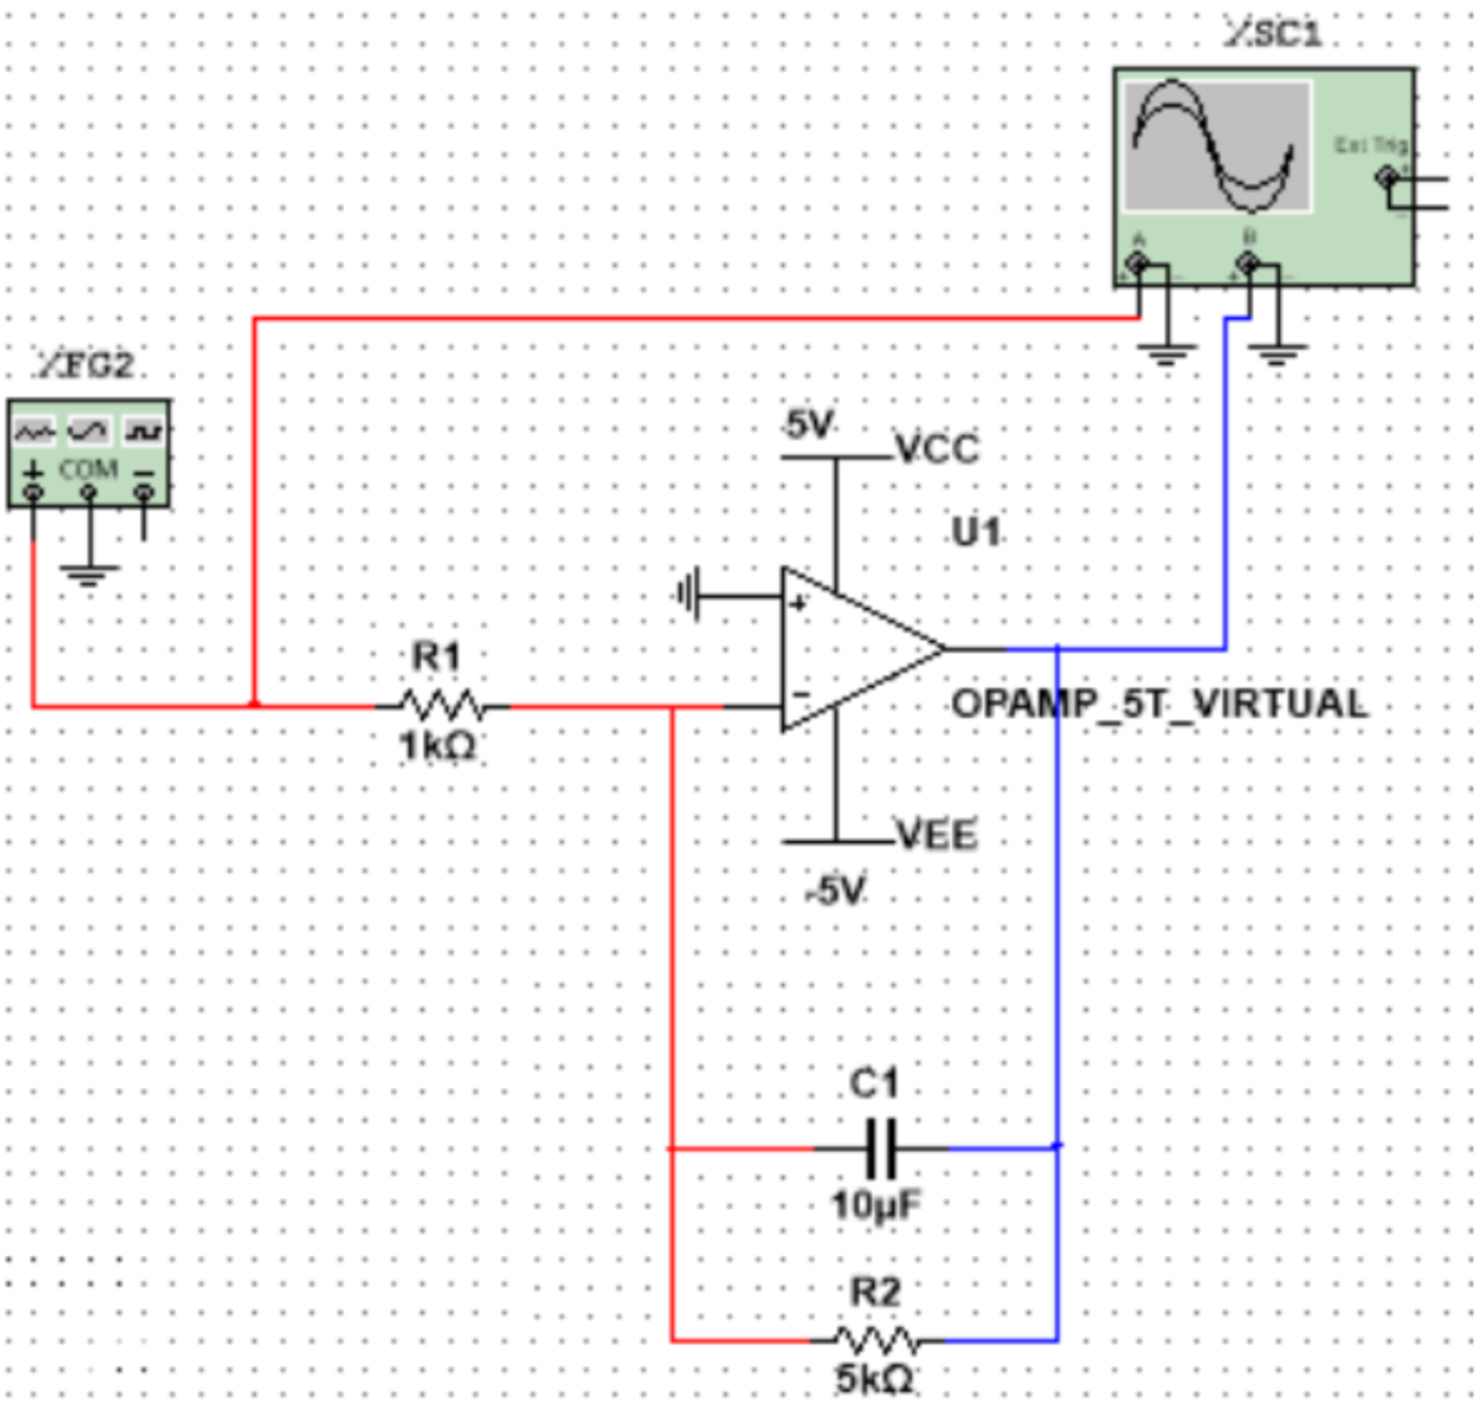
Demo - ECEN 215 Lab 7 Exercise
Build the pictured circuit
Set the wave generator to the following settings:
AC Sine Wave • f = 30 Hz • Phase Shift = 0° • Offset = 0 V • Amplitude = .5 V
Record the input and output waveforms using the scope tool.
Measure the amplitudes of both Vin and Vout, and the phase shift between the waves.
Do the same but with square wave
Now triangle wave

Slide 7
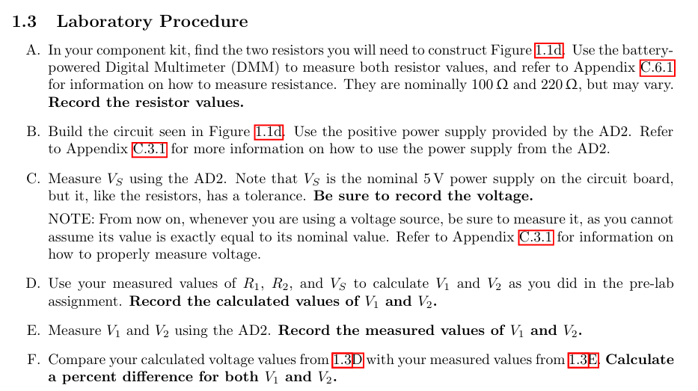
Lab 1

Slide 8
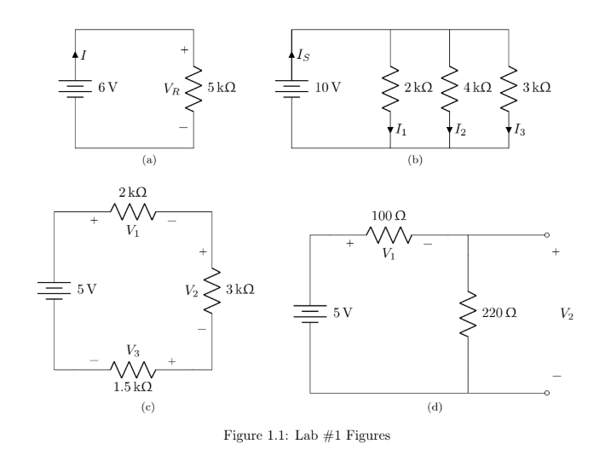
Lab 1
Measuring voltage and current across resistors

Slide 9
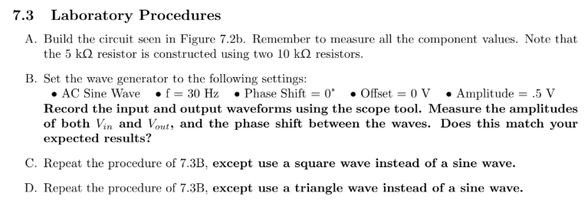
Lab 7

Slide 10
Mobile App Validation
Discovery:
Devices are discovered within 4 seconds
Connection Stability:
Verified stable connection to device for at least 30 minutes
Reconnection:
App can disconnect from device and reconnect immediately
Read/Write Operations:
Verified app sending/receiving messages through VSCode terminal and system functionality
Connection Latency:
App constantly connects within 1.5 second
Command Response Time:
Data is sent to the app within 0.25 seconds after requesting
Device Compatibility:
App has been installed and operated on multiple devices with various software anywhere from 2 years of age to 10 years of age
Interference:
In performing this demo the app shows stable connection in an environment with abundant BL traffic

Slide 11
Waveform Generator Validation
Discovery:
Devices are discovered within 4 seconds
Connection:
App receives data from each of the waveforms that can be shown on VScode
Can Switch between each waveform shape without any disruptions
Characteristics:
Verify that the waveform characteristics are corresponding with each lab
Frequency and amplitude
Noise:
Verify that waveshapes are easy to read and measure

Slide 12
Multimeter/Oscilloscope Validation
App-Multimeter Connectivity
Microcontroller sends data through bluetooth to the app from terminal and system functionality
App-Oscilloscope Connectivity:
Graphed oscilloscope readings onto app
Voltage
Expected | Actual | Percent Error
5 V | 4.96V | 0.8%
2.5 V | 2.43 | 2.8%
0 V | .024 | ~~~
Resistance
Expected | Actual | Percent Error
10000 | 9814.343 | 1.89%
1000 | 1005.385 | 0.09%
100 | 108.28 | 7.6%

Slide 13
PCB/Power Validation
Power Systems Results | Expected | Actual
System 1 | 5 V | 4.987
System 2 | 3.3 V | 3.319
System 3 | -5 V | -4.976
Switching System Results | ESP Low | ESP High
Switch 1 | 0.019 mV | 4.93 V
Switch 2 | -4.975 V | -4.973 V

Slide 14
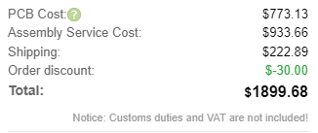
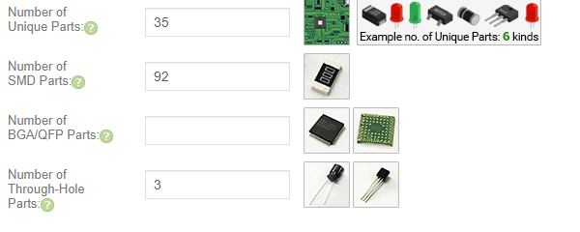
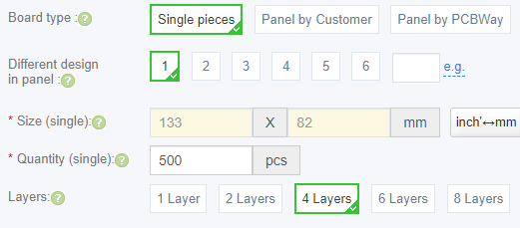
PCB/Power Validation
Price and Size Analysis:
Altium Price Analysis: $44.57
JLC Price Analysis per 500: $3.80
Wall Adapter: $8.83
Overall Estimate: $57.20 per board
Case Size: 156.7x85.6x21.7mm
Area increase vs. phone: 24%

Slide 15
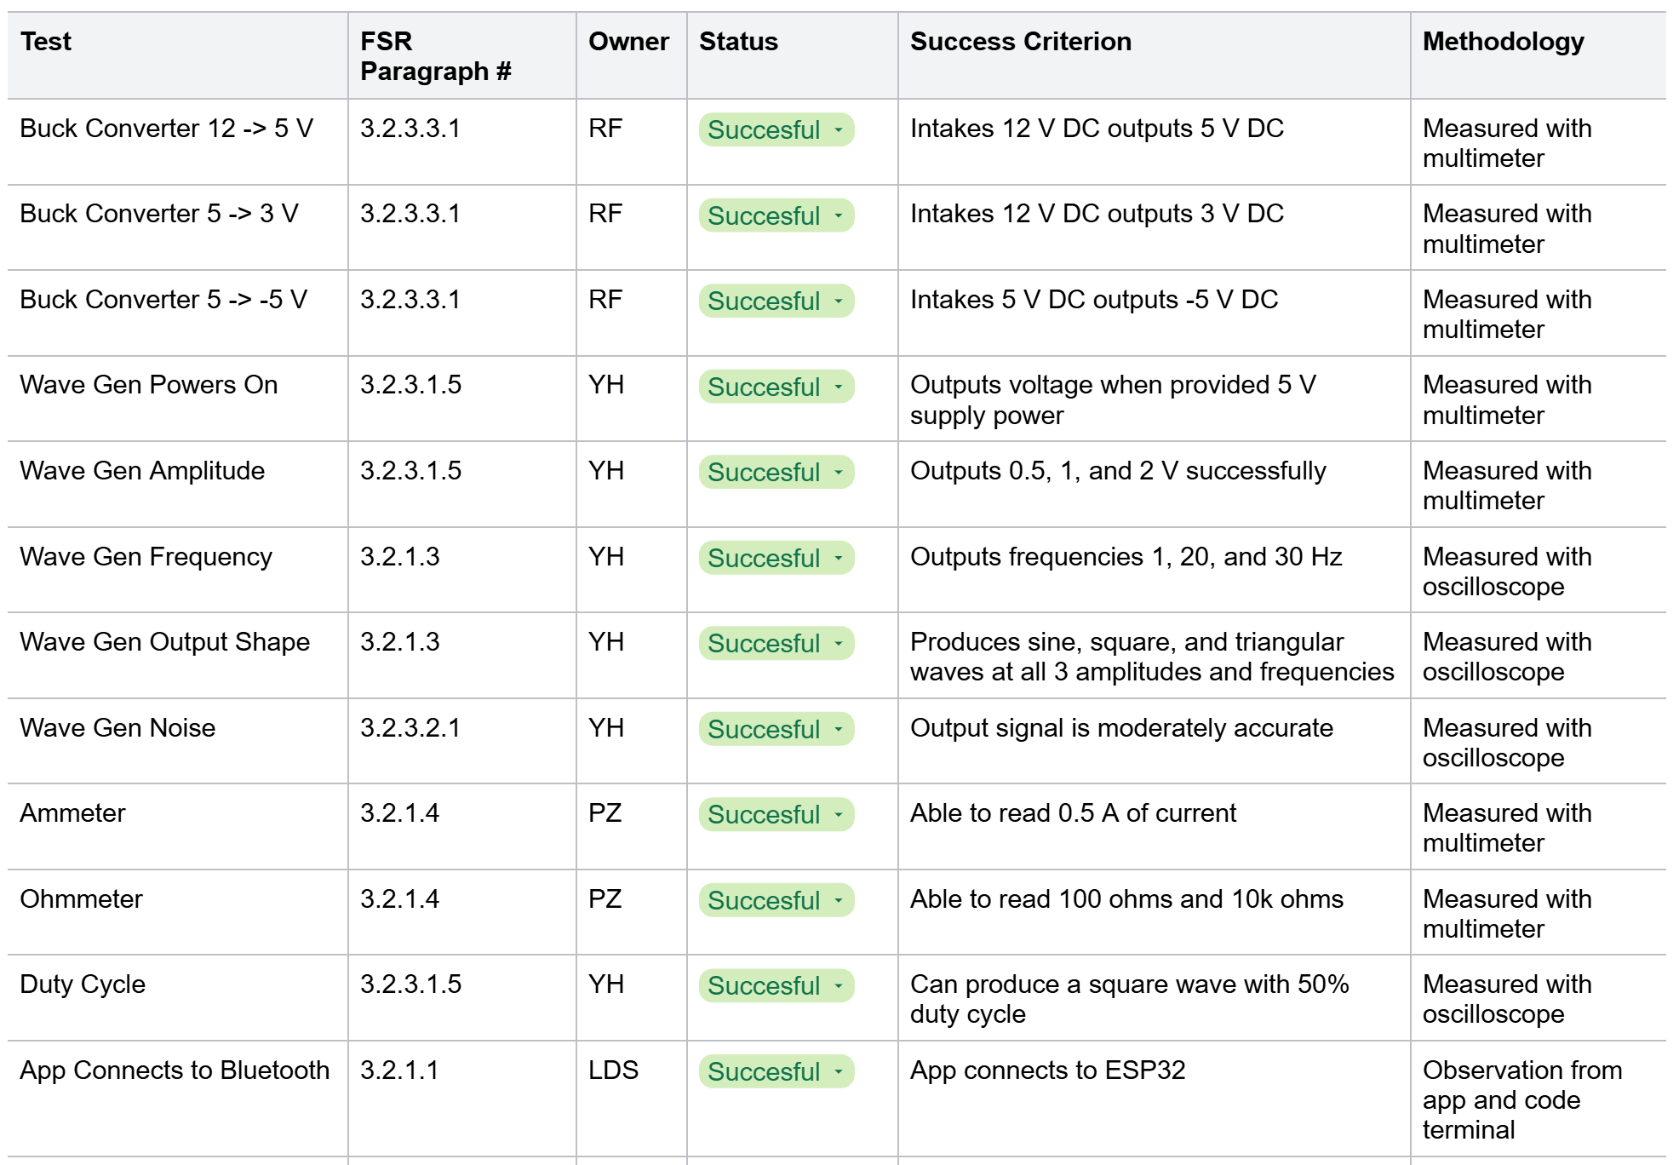
Overall Validation Plan

Slide 16
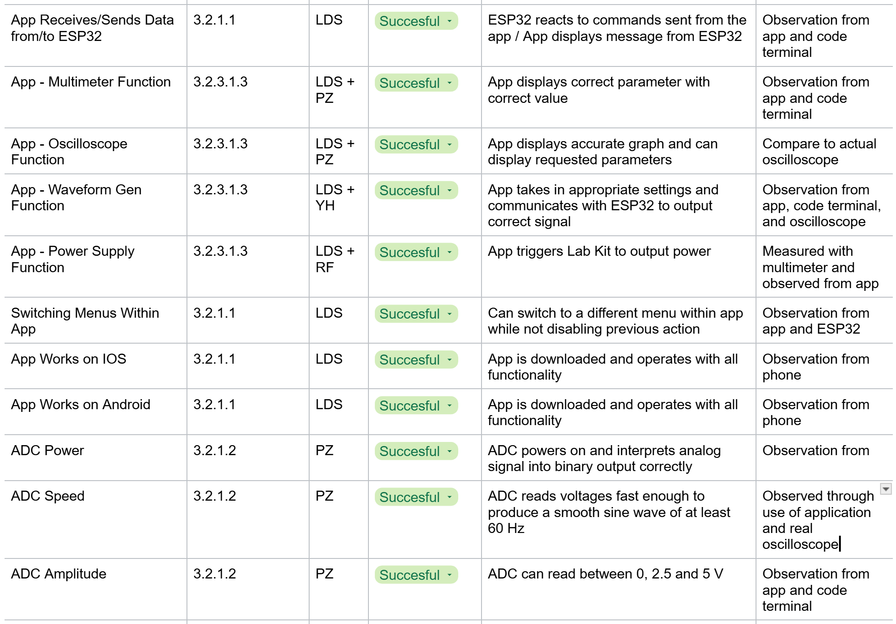
Overall Validation Plan Cont.

Slide 17
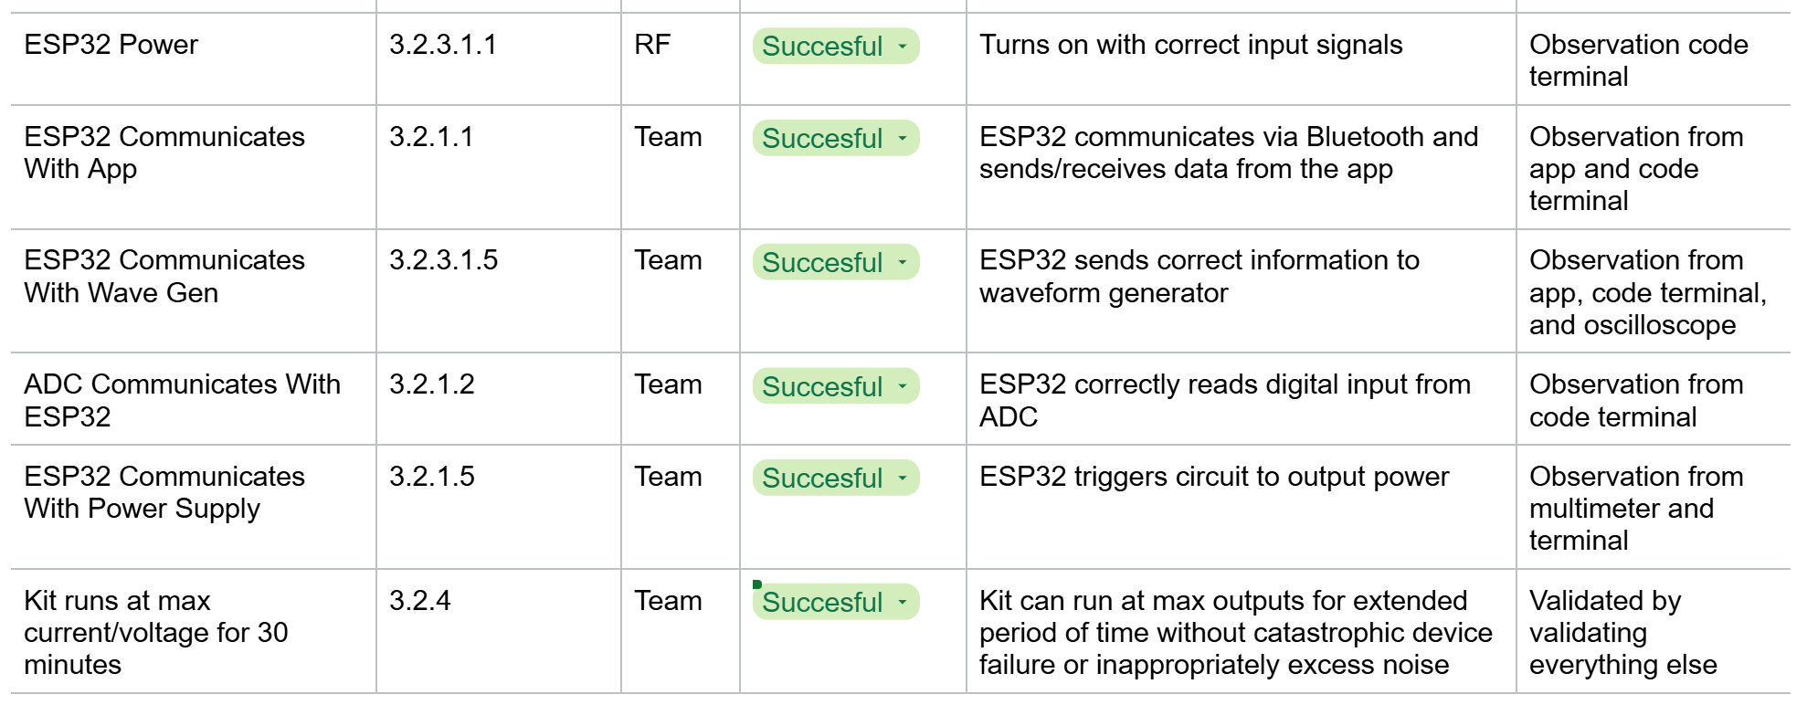
Overall Validation Plan Cont.

Slide 18
Demo Videos
Wavegen
Wavegen Demo
Triangle
Square
Sine
Oscilloscope
Square
Triangle
Ammeter
Test

